Slide 1
Planet System Simulator
Jonathan Albert
Kevin Ireland
Adnan Khan
Joshua Zwolan

Slide 2
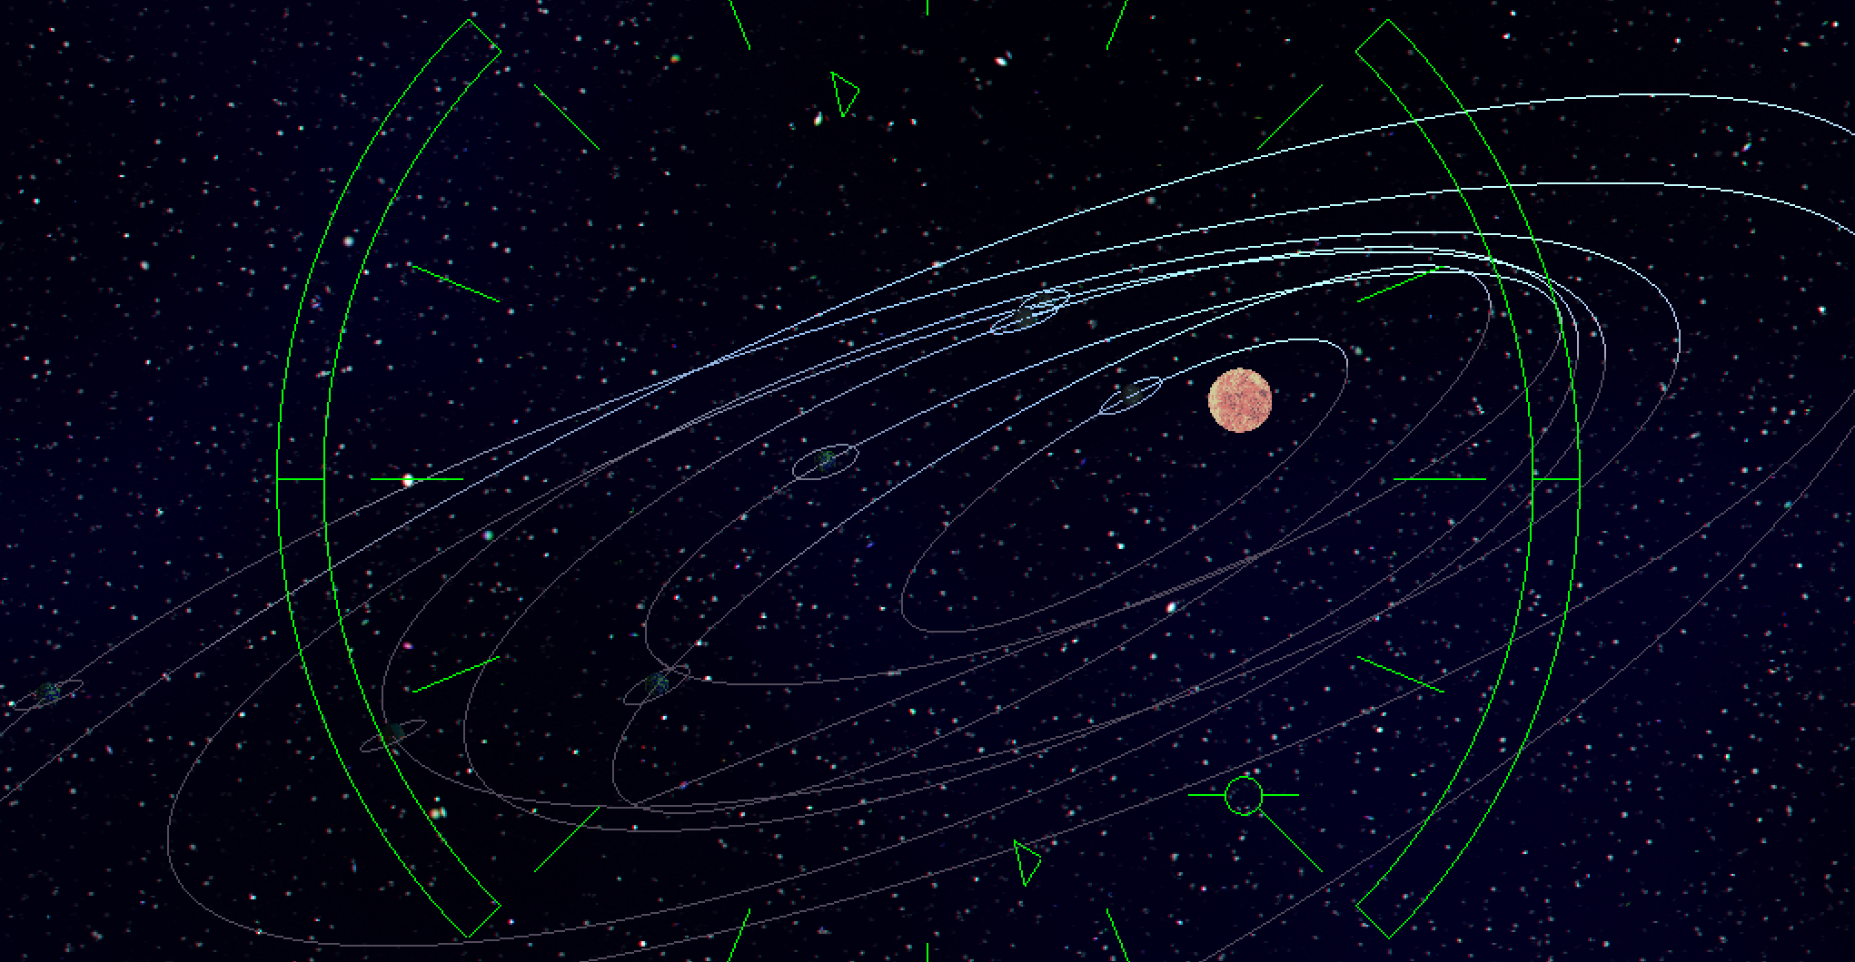

Slide 3
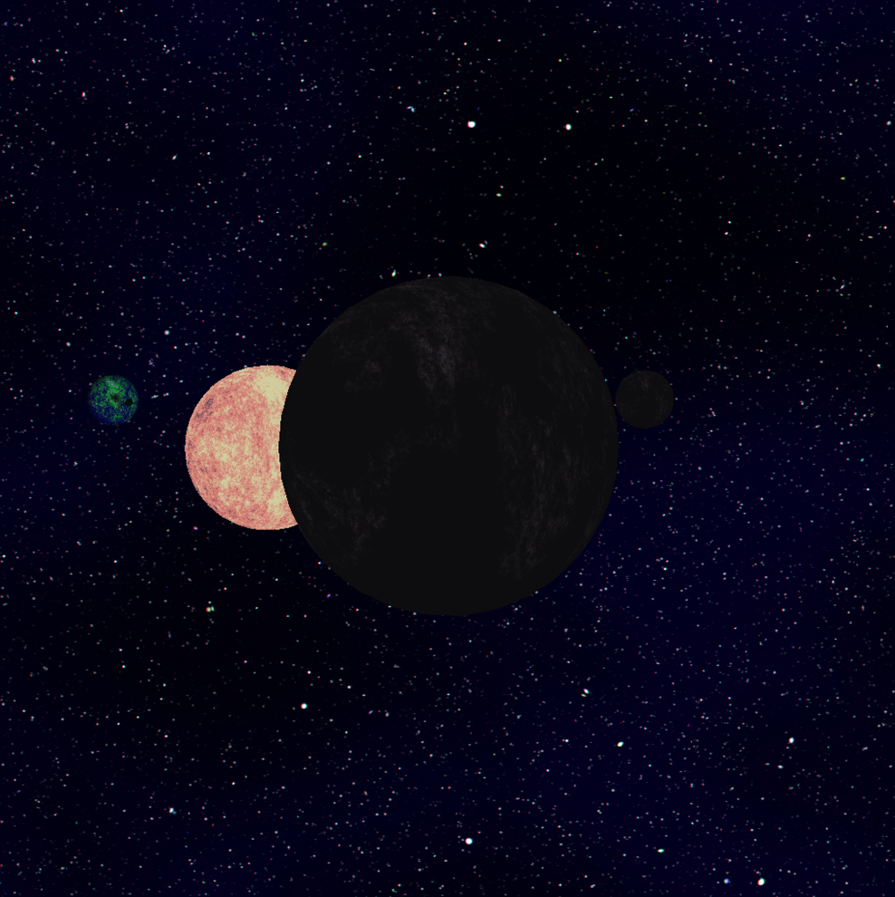
Overview
Planetary system simulator
2 View Options
Ship Camera
Planet Follower

Slide 4
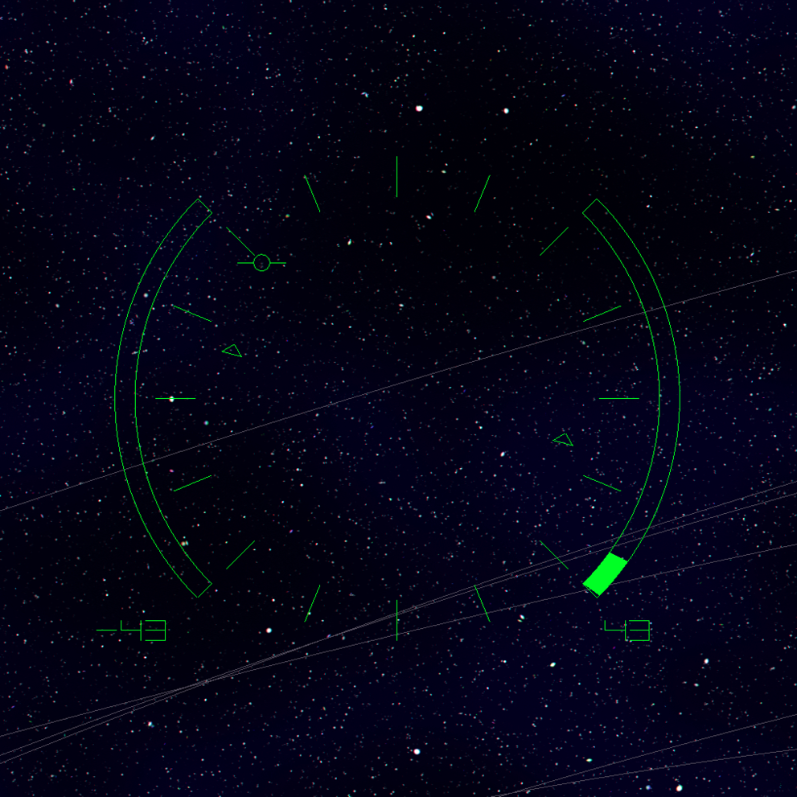
UI
2D drawn on top of 3D scene
Features:
Text Display for Speed
Rotational orientation display
Degree markers
Center Reticle indicating mouse
Future use: if we implement mouse grabbing this can aid in movement.

Slide 5
Camera
Ship Based Camera:
Cross products were very useful
After calculations values were passed into gluLookat to specify the camera
Planet Following Camera

Slide 6
Planet Movement
Handled separately from the rendering loop
Orbital planes defined using random normal vector which defined the orientation of the plane with respect to its orbital parent.
Orbits are drawn to illustrate planet motion

Slide 7
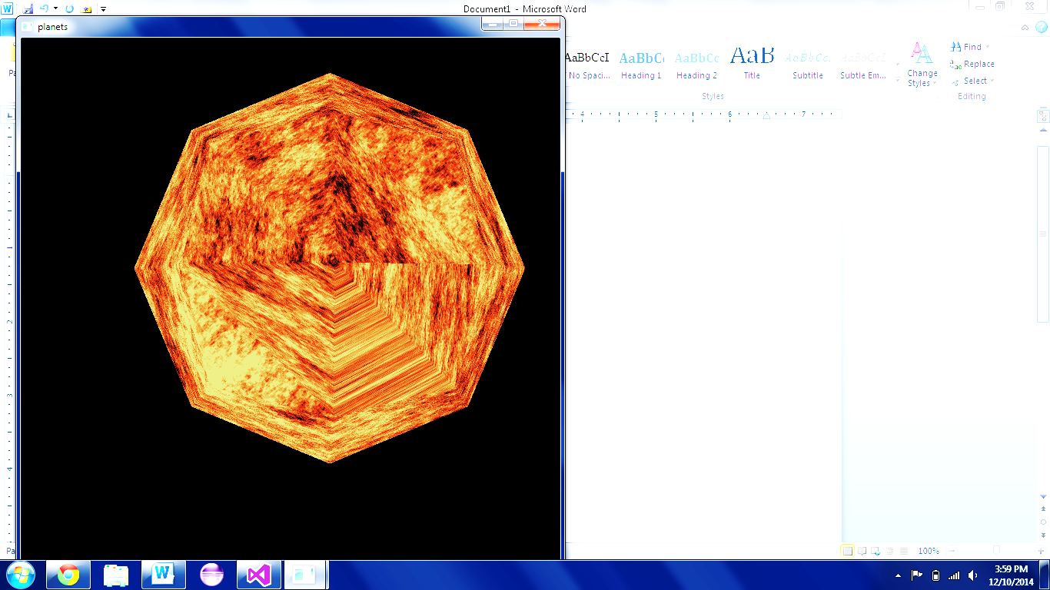
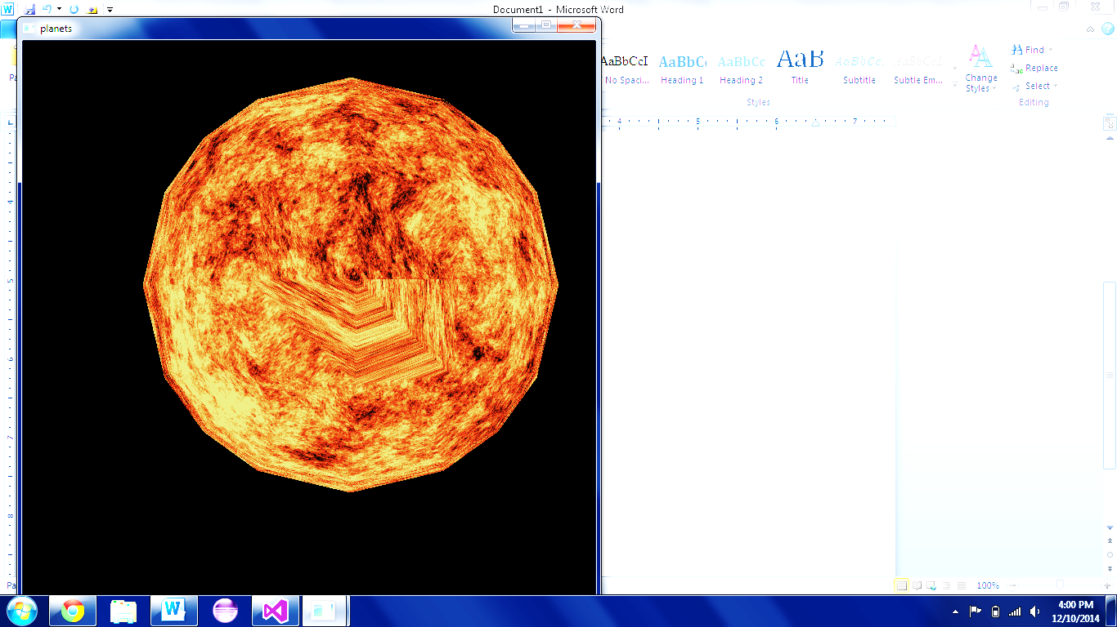

Planet Texturing
Procedurally generated textures using Brownian motion algorithm.
Textures were sphere mapped to the cube

Slide 8
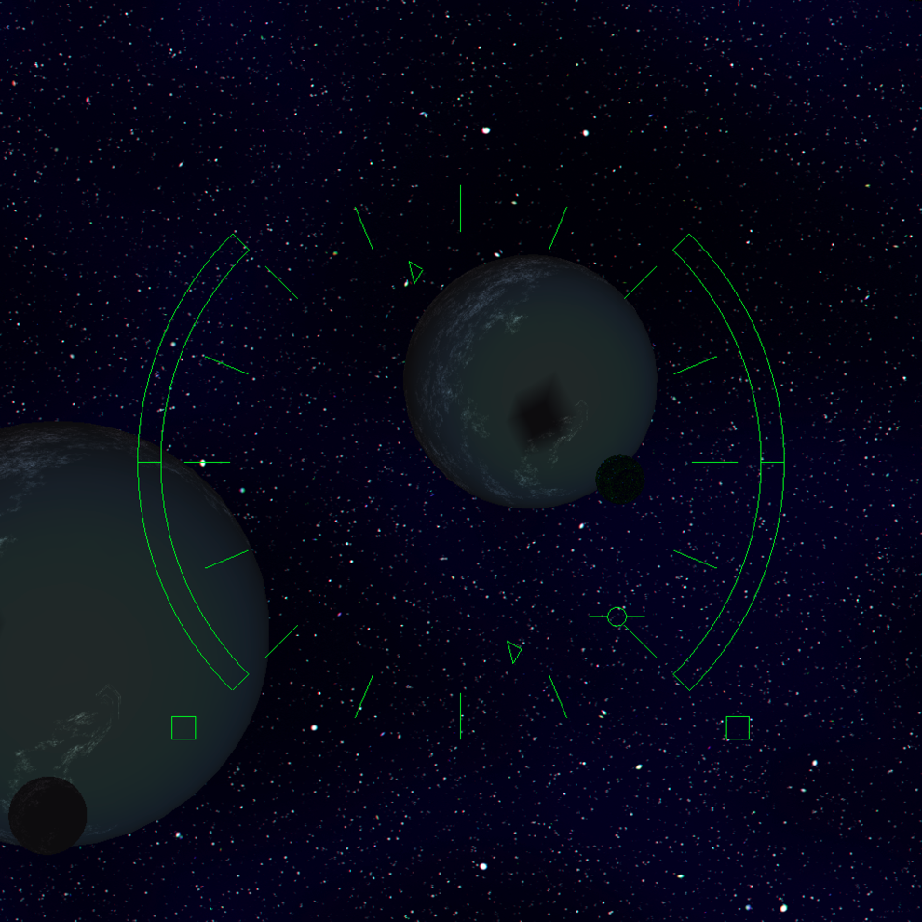
Lighting and Shading
Objects in interactive mode are shaded, but there are not any inter-object interactions.
To see shadows we need to use our RayTracer mode to take a snapshot in which there are shadows as can be seen on the right.

Slide 9
Further possibilities
Drawing the Spaceship itself
Multiple Suns in wide orbits of each other
Non-spherical objects

